Slide 1
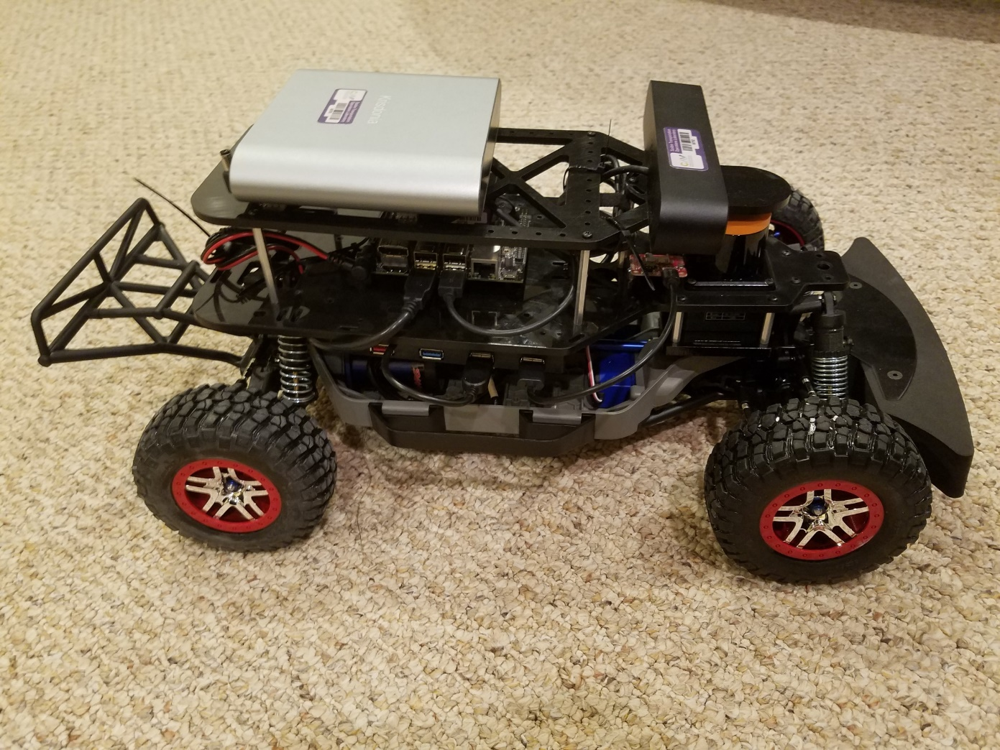
CARMA 1tenth initial work
Alex Frye

Slide 2
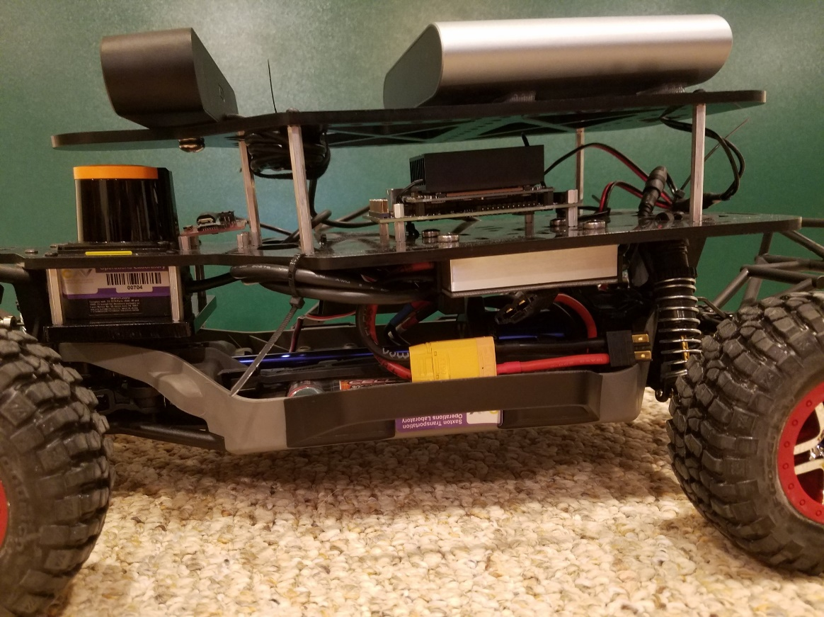
Components
Jetson Xavier NX [red]
384-core NVIDIA Volta™ GPU with 48 Tensor Cores
6-core NVIDIA Carmel ARM®v8.2 64-bit CPU
8GB 1600MHz RAM
Hokuyo UST-10LX Lidar [green]
270-degree FOV, 10m range, single laser
40Hz measurement rate
ZED 2 RGB binocular camera [blue]
Integrated 9-axis IMU, barometer, and thermometer
30fps 1080p / 60fps 720p
Sparkfun Razor 9-axis IMU [yellow]
3-axis accelerometer, gyro, and magnetometer

Slide 3


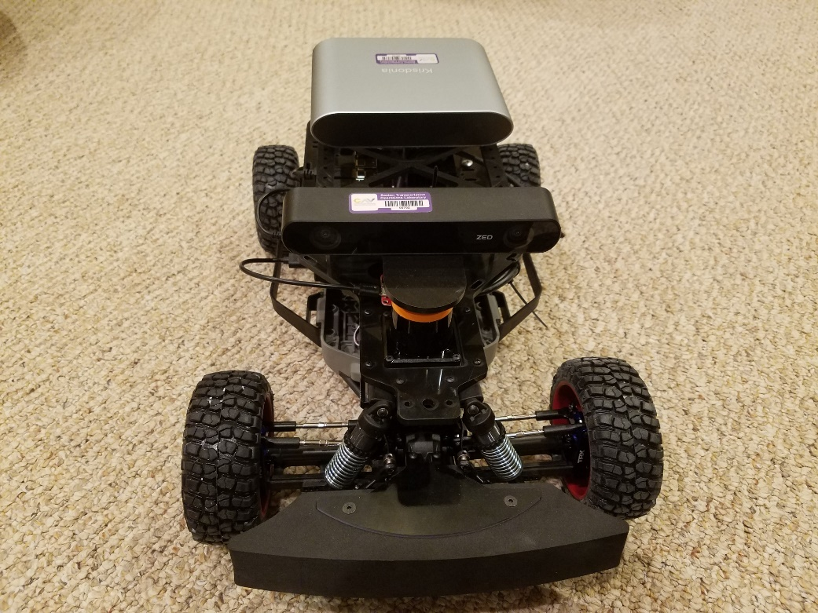
Work done
All sensors functional

Slide 4
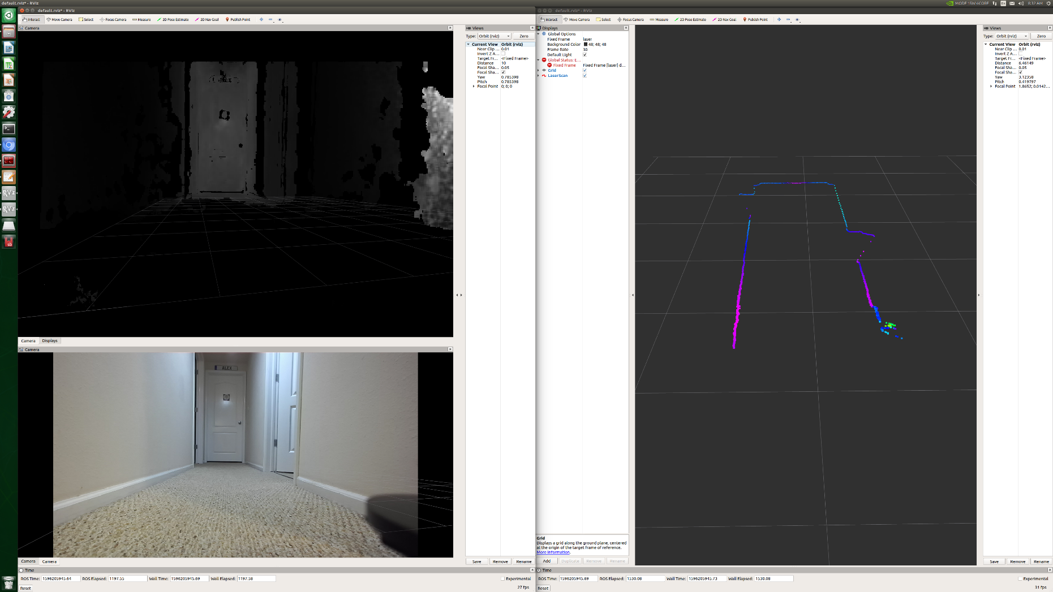
Example sensor outputs

Slide 5
Hardware and software setup
Created instructions document
Summarized FHWA intern discussions
CARMA 1tenth Vector

Slide 6
Next steps/Future work
Start integrating CARMA
Add GPU compute to CARMA to take full advantage of the Xavier NX
Hackathon getting students to convert sections of CARMA
Add CARMA 1tenth to CAVE-in-a-box as a CAV teaching aid
Add AI model for better/faster decisions on driving/localization

Slide 7
Full BOM
Component | Quantity | Link
RaceCarJ base + Extra batteries | 1 | https://racecarj.com/products/racecar-j-robot-base-kit?variant=357037735956
NVIDIA Jetson NX Xavier Developer Kit | 1 | https://www.amazon.com/NVIDIA-Jetson-Xavier-Developer-Kit/dp/B086874Q5R/ref=sr_1_2?dchild=1&keywords=xavier+nx&qid=1589461123&sr=8-2
LIDAR - Hokuyo UST-10LX | 1 | https://acroname.com/products/HOKUYO-UST-10LX-LASER
ZED2 Camera | 1 | https://store.stereolabs.com/products/zed-2?_ga=2.48830625.683630121.1590062343-735880675.1590062343
Krisdonia Portable Laptop Charger | 1 | https://www.amazon.com/dp/B076GYGR6M/ref=emc_b_5_t?th=1
SSD | 1 | https://www.amazon.com/dp/B07M7Q21N7/ref=twister_B07NLZ58HW?_encoding=UTF8&psc=1
4 AA batteries | 1 | http://amzn.to/29EIImY

